Slide 1
CSH3J3 SISTEM PARALEL DAN TERDISTRIBUSI
MATERI: Model Paralel Programming

Slide 2
Outline Today
Parallel Programming Model
Programming model
Design parallel program

Slide 3
Parallel programming model

Slide 4
Parallel programming models
Shared Memory (without threads)
Threads
Distributed Memory / Message Passing
Data Parallel
Hybrid
Single Program Multiple Data (SPMD)
Multiple Program Multiple Data (MPMD)

Slide 5
Cont.
Parallel programming models exist as an abstraction above hardware and memory architectures.
Although it might not seem apparent, these models are NOT specific to a particular type of machine or memory architecture. In fact, any of these models can (theoretically) be implemented on any underlying hardware.

Slide 6
SHARED memory model on a DISTRIBUTED memory machine
Kendall Square Research (KSR) ALLCACHE approach. Machine memory was physically distributed across networked machines, but appeared to the user as a single shared memory global address space. Generically, this approach is referred to as "virtual shared memory"

Slide 7
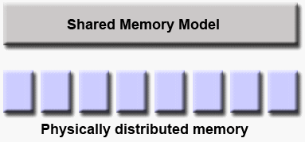

Slide 8
DISTRIBUTED memory model on a SHARED memory machine
Message Passing Interface (MPI) on SGI Origin 2000. The SGI Origin 2000 employed the CC-NUMA type of shared memory architecture, where every task has direct access to global address space spread across all machines. However, the ability to send and receive messages using MPI, as is commonly done over a network of distributed memory machines, was implemented and commonly used.

Slide 9
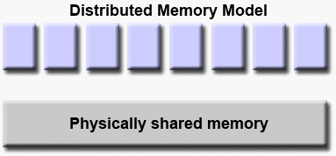

Slide 10
Which model to use?
This is often a combination of what is available and personal choice. There is no "best" model, although there certainly are better implementations of some models over others

Slide 11
Shared Memory Model (without threads)
In this programming model, processes/tasks share a common address space, which they read and write to asynchronously.
Various mechanisms such as locks / semaphores are used to control access to the shared memory, resolve contentions and to prevent race conditions and deadlocks.
This is perhaps the simplest parallel programming model.

Slide 12
Cont.
An advantage of this model from the programmer's point of view is that the notion of data "ownership" is lacking, so there is no need to specify explicitly the communication of data between tasks. All processes see and have equal access to shared memory. Program development can often be simplified.
An important disadvantage in terms of performance is that it becomes more difficult to understand and manage data locality:
Keeping data local to the process that works on it conserves memory accesses, cache refreshes and bus traffic that occurs when multiple processes use the same data.
Unfortunately, controlling data locality is hard to understand and may be beyond the control of the average user.

Slide 13
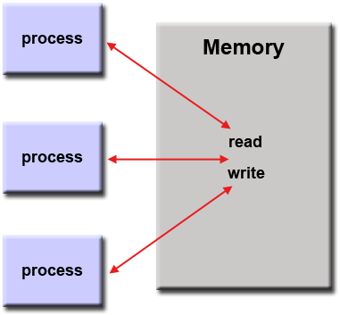

Slide 14
Implementations
On stand-alone shared memory machines, native operating systems, compilers and/or hardware provide support for shared memory programming. For example, the POSIX standard provides an API for using shared memory, and UNIX provides shared memory segments (shmget, shmat, shmctl, etc).
On distributed memory machines, memory is physically distributed across a network of machines, but made global through specialized hardware and software. A variety of SHMEM implementations are available: http://en.wikipedia.org/wiki/SHMEM.

Slide 15
Threads Model
This programming model is a type of shared memory programming.
In the threads model of parallel programming, a single "heavy weight" process can have multiple "light weight", concurrent execution paths.

Slide 16
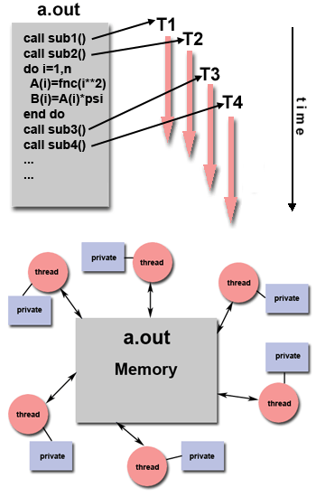

Slide 17
The main program a.out is scheduled to run by the native operating system. a.out loads and acquires all of the necessary system and user resources to run. This is the "heavy weight" process.
a.out performs some serial work, and then creates a number of tasks (threads) that can be scheduled and run by the operating system concurrently.
Each thread has local data, but also, shares the entire resources of a.out. This saves the overhead associated with replicating a program's resources for each thread ("light weight"). Each thread also benefits from a global memory view because it shares the memory space of a.out.

Slide 18
A thread's work may best be described as a subroutine within the main program. Any thread can execute any subroutine at the same time as other threads.
Threads communicate with each other through global memory (updating address locations). This requires synchronization constructs to ensure that more than one thread is not updating the same global address at any time.
Threads can come and go, but a.out remains present to provide the necessary shared resources until the application has completed.

Slide 19
Implementation
From a programming perspective, threads implementations commonly comprise:
A library of subroutines that are called from within parallel source code
A set of compiler directives imbedded in either serial or parallel source code
In both cases, the programmer is responsible for determining the parallelism (although compilers can sometimes help).
Threaded implementations are not new in computing. Historically, hardware vendors have implemented their own proprietary versions of threads. These implementations differed substantially from each other making it difficult for programmers to develop portable threaded applications.
Unrelated standardization efforts have resulted in two very different implementations of threads: POSIX Threads and OpenMP.

Slide 20
POSIX Threads
Specified by the IEEE POSIX 1003.1c standard (1995). C Language only.
Part of Unix/Linux operating systems
Library based
Commonly referred to as Pthreads.
Very explicit parallelism; requires significant programmer attention to detail.

Slide 21
OpenMP
Industry standard, jointly defined and endorsed by a group of major computer hardware and software vendors, organizations and individuals.
Compiler directive based
Portable / multi-platform, including Unix and Windows platforms
Available in C/C++ and Fortran implementations
Can be very easy and simple to use - provides for "incremental parallelism". Can begin with serial code.

Slide 22
Distributed Memory / Message Passing Model
A set of tasks that use their own local memory during computation. Multiple tasks can reside on the same physical machine and/or across an arbitrary number of machines.
Tasks exchange data through communications by sending and receiving messages.
Data transfer usually requires cooperative operations to be performed by each process. For example, a send operation must have a matching receive operation.

Slide 23
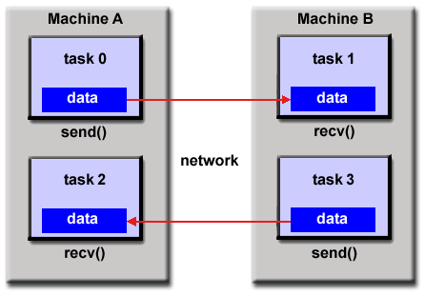

Slide 24
Implementations
From a programming perspective, message passing implementations usually comprise a library of subroutines. Calls to these subroutines are imbedded in source code. The programmer is responsible for determining all parallelism.
Historically, a variety of message passing libraries have been available since the 1980s. These implementations differed substantially from each other making it difficult for programmers to develop portable applications.
In 1992, the MPI Forum was formed with the primary goal of establishing a standard interface for message passing implementations.

Slide 25
Cont.
Part 1 of the Message Passing Interface (MPI) was released in 1994. Part 2 (MPI-2) was released in 1996 and MPI-3 in 2012. All MPI specifications are available on the web at http://www.mpi-forum.org/docs/.
MPI is the "de facto" industry standard for message passing, replacing virtually all other message passing implementations used for production work. MPI implementations exist for virtually all popular parallel computing platforms. Not all implementations include everything in MPI-1, MPI-2 or MPI-3.

Slide 26
Data Parallel Model
May also be referred to as the Partitioned Global Address Space (PGAS) model.
The data parallel model demonstrates the following characteristics:
Address space is treated globally
Most of the parallel work focuses on performing operations on a data set. The data set is typically organized into a common structure, such as an array or cube.
A set of tasks work collectively on the same data structure, however, each task works on a different partition of the same data structure.
Tasks perform the same operation on their partition of work, for example, "add 4 to every array element".

Slide 27
Cont.
On shared memory architectures, all tasks may have access to the data structure through global memory.
On distributed memory architectures the data structure is split up and resides as "chunks" in the local memory of each task.

Slide 28
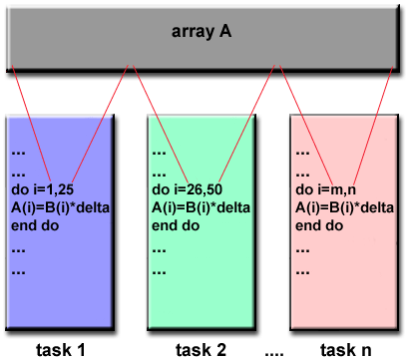

Slide 29
Implementations
Currently, there are several relatively popular, and sometimes developmental, parallel programming implementations based on the Data Parallel / PGAS model.
Coarray Fortran: a small set of extensions to Fortran 95 for SPMD parallel programming. Compiler dependent. More information: https://en.wikipedia.org/wiki/Coarray_Fortran
Unified Parallel C (UPC): an extension to the C programming language for SPMD parallel programming. Compiler dependent. More information: http://upc.lbl.gov/

Slide 30
Cont.
Global Arrays: provides a shared memory style programming environment in the context of distributed array data structures. Public domain library with C and Fortran77 bindings. More information: https://en.wikipedia.org/wiki/Global_Arrays
X10: a PGAS based parallel programming language being developed by IBM at the Thomas J. Watson Research Center. More information: http://x10-lang.org/
Chapel: an open source parallel programming language project being led by Cray. More information: http://chapel.cray.com/

Slide 31
Hybrid Model
A hybrid model combines more than one of the previously described programming models.
Currently, a common example of a hybrid model is the combination of the message passing model (MPI) with the threads model (OpenMP).
Threads perform computationally intensive kernels using local, on-node data
Communications between processes on different nodes occurs over the network using MPI
This hybrid model lends itself well to the most popular (currently) hardware environment of clustered multi/many-core machines.

Slide 32
Cont.
Another similar and increasingly popular example of a hybrid model is using MPI with CPU-GPU (Graphics Processing Unit) programming.
MPI tasks run on CPUs using local memory and communicating with each other over a network.
Computationally intensive kernels are off-loaded to GPUs on-node.
Data exchange between node-local memory and GPUs uses CUDA (or something equivalent).
Other hybrid models are common:
MPI with Pthreads
MPI with non-GPU accelerators

Slide 33
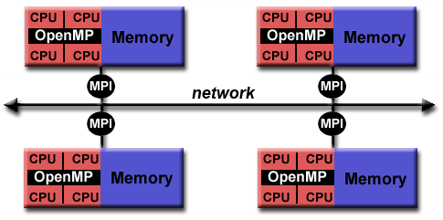

Slide 34
Single Program Multiple Data (SPMD)
SPMD is actually a "high level" programming model that can be built upon any combination of the previously mentioned parallel programming models.
SINGLE PROGRAM: All tasks execute their copy of the same program simultaneously. This program can be threads, message passing, data parallel or hybrid.
MULTIPLE DATA: All tasks may use different data
SPMD programs usually have the necessary logic programmed into them to allow different tasks to branch or conditionally execute only those parts of the program they are designed to execute. That is, tasks do not necessarily have to execute the entire program - perhaps only a portion of it.
The SPMD model, using message passing or hybrid programming, is probably the most commonly used parallel programming model for multi-node clusters.

Slide 36
Multiple Program Multiple Data (MPMD)
Like SPMD, MPMD is actually a "high level" programming model that can be built upon any combination of the previously mentioned parallel programming models.
MULTIPLE PROGRAM: Tasks may execute different programs simultaneously. The programs can be threads, message passing, data parallel or hybrid.
MULTIPLE DATA: All tasks may use different data
MPMD applications are not as common as SPMD applications, but may be better suited for certain types of problems, particularly those that lend themselves better to functional decomposition than domain decomposition (discussed later under Partioning).

Slide 38
Design parallel program

Slide 39
Design Parallel Program
Understand the problem and program
Partitioning
Communication
Synchronization
Data Dependencies
Load Balancing
Granularity
I/O

Slide 40
Understand the Problem and the Program
Undoubtedly, the first step in developing parallel software is to first understand the problem that you wish to solve in parallel. If you are starting with a serial program, this necessitates understanding the existing code also.
Before spending time in an attempt to develop a parallel solution for a problem, determine whether or not the problem is one that can actually be parallelized.

Slide 41
Easy to parallelize problem
Calculate the potential energy for each of several thousand independent conformations of a molecule. When done, find the minimum energy conformation.
This problem is able to be solved in parallel. Each of the molecular conformations is independently determinable. The calculation of the minimum energy conformation is also a parallelizable problem.

Slide 42
Problem with little-to-no parallelism
Calculation of the Fibonacci series (0,1,1,2,3,5,8,13,21,...) by use of the formula:F(n) = F(n-1) + F(n-2)
The calculation of the F(n) value uses those of both F(n-1) and F(n-2), which must be computed first.

Slide 43
Identify the program's hotspots
Know where most of the real work is being done. The majority of scientific and technical programs usually accomplish most of their work in a few places.
Profilers and performance analysis tools can help here
Focus on parallelizing the hotspots and ignore those sections of the program that account for little CPU usage.

Slide 44
Identify bottlenecks in the program:
Are there areas that are disproportionately slow, or cause parallelizable work to halt or be deferred? For example, I/O is usually something that slows a program down.
May be possible to restructure the program or use a different algorithm to reduce or eliminate unnecessary slow areas

Slide 45
Cont.
Identify inhibitors to parallelism. One common class of inhibitor is data dependence, as demonstrated by the Fibonacci sequence above.
Investigate other algorithms if possible. This may be the single most important consideration when designing a parallel application.
Take advantage of optimized third party parallel software and highly optimized math libraries available from leading vendors (IBM's ESSL, Intel's MKL, AMD's AMCL, etc.)

Slide 46
Partitioning
One of the first steps in designing a parallel program is to break the problem into discrete "chunks" of work that can be distributed to multiple tasks. This is known as decomposition or partitioning.
There are two basic ways to partition computational work among parallel tasks: domain decomposition and functional decomposition.

Slide 47
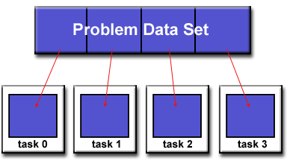
Domain Decomposition
In this type of partitioning, the data associated with a problem is decomposed. Each parallel task then works on a portion of the data.

Slide 48
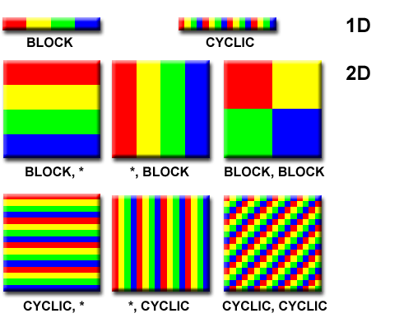
There are different ways to partition data

Slide 49
Functional Decomposition
In this approach, the focus is on the computation that is to be performed rather than on the data manipulated by the computation. The problem is decomposed according to the work that must be done. Each task then performs a portion of the overall work

Slide 50
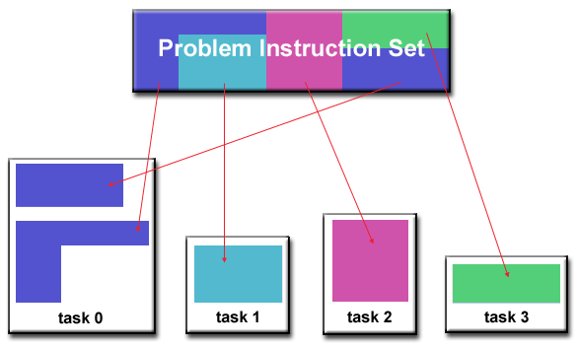

Slide 51
Ecosystem Modeling
Each program calculates the population of a given group, where each group's growth depends on that of its neighbors. As time progresses, each process calculates its current state, then exchanges information with the neighbor populations. All tasks then progress to calculate the state at the next time step.

Slide 52
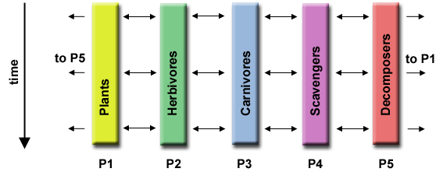

Slide 53
Signal Processing
An audio signal data set is passed through four distinct computational filters. Each filter is a separate process. The first segment of data must pass through the first filter before progressing to the second. When it does, the second segment of data passes through the first filter. By the time the fourth segment of data is in the first filter, all four tasks are busy.

Slide 54
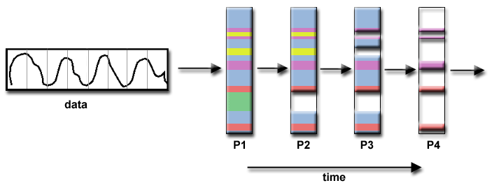

Slide 55
Climate Modeling
Each model component can be thought of as a separate task. Arrows represent exchanges of data between components during computation: the atmosphere model generates wind velocity data that are used by the ocean model, the ocean model generates sea surface temperature data that are used by the atmosphere model, and so on.

Slide 56
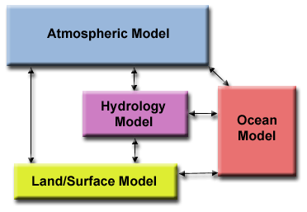

Slide 57
Who Needs Communications?
The need for communications between tasks depends upon your problem:
You DON'T need communications
Some types of problems can be decomposed and executed in parallel with virtually no need for tasks to share data. For example, imagine an image processing operation where every pixel in a black and white image needs to have its color reversed. The image data can easily be distributed to multiple tasks that then act independently of each other to do their portion of the work.
These types of problems are often called embarrassingly parallel because they are so straight-forward. Very little inter-task communication is required.

Slide 58
Cont.
You DO need communicationsMost parallel applications are not quite so simple, and do require tasks to share data with each other. For example, a 3-D heat diffusion problem requires a task to know the temperatures calculated by the tasks that have neighboring data. Changes to neighboring data has a direct effect on that task's data.

Slide 59
Factors to consider when designing program's inter-task communications:
Cost of communications
Latency vs. Bandwidth
Visibility of communications
Synchronous vs. asynchronous communications
Scope of communications
Efficiency of communications
Overhead and Complexity

Slide 60
Cost of communications
Inter-task communication virtually always implies overhead.
Machine cycles and resources that could be used for computation are instead used to package and transmit data.
Communications frequently require some type of synchronization between tasks, which can result in tasks spending time "waiting" instead of doing work.
Competing communication traffic can saturate the available network bandwidth, further aggravating performance problems

Slide 61
Latency vs. Bandwidth
latency is the time it takes to send a minimal (0 byte) message from point A to point B. Commonly expressed as microseconds.
bandwidth is the amount of data that can be communicated per unit of time. Commonly expressed as megabytes/sec or gigabytes/sec.
Sending many small messages can cause latency to dominate communication overheads. Often it is more efficient to package small messages into a larger message, thus increasing the effective communications bandwidth.

Slide 62
Visibility of communications
With the Message Passing Model, communications are explicit and generally quite visible and under the control of the programmer.
With the Data Parallel Model, communications often occur transparently to the programmer, particularly on distributed memory architectures. The programmer may not even be able to know exactly how inter-task communications are being accomplished.

Slide 63
Synchronous vs. asynchronous communications
Synchronous communications require some type of "handshaking" between tasks that are sharing data. This can be explicitly structured in code by the programmer, or it may happen at a lower level unknown to the programmer.
Synchronous communications are often referred to as blocking communications since other work must wait until the communications have completed.
Asynchronous communications allow tasks to transfer data independently from one another. For example, task 1 can prepare and send a message to task 2, and then immediately begin doing other work. When task 2 actually receives the data doesn't matter.
Asynchronous communications are often referred to as non-blocking communications since other work can be done while the communications are taking place.
Interleaving computation with communication is the single greatest benefit for using asynchronous communications.

Slide 64
Scope of communications
Knowing which tasks must communicate with each other is critical during the design stage of a parallel code. Both of the two scopings described below can be implemented synchronously or asynchronously.
Point-to-point - involves two tasks with one task acting as the sender/producer of data, and the other acting as the receiver/consumer.
Collective - involves data sharing between more than two tasks, which are often specified as being members in a common group, or collective. Some common variations (there are more):

Slide 65
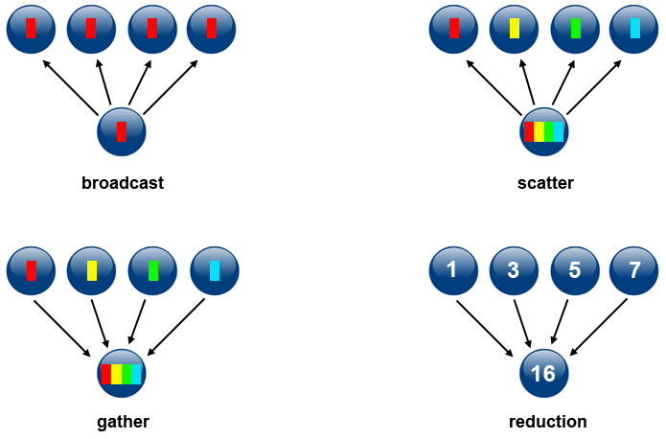

Slide 66
Efficiency of communications
Very often, the programmer will have a choice with regard to factors that can affect communications performance. Only a few are mentioned here.
Which implementation for a given model should be used? Using the Message Passing Model as an example, one MPI implementation may be faster on a given hardware platform than another.
What type of communication operations should be used? As mentioned previously, asynchronous communication operations can improve overall program performance.
Network media - some platforms may offer more than one network for communications. Which one is best?

Slide 67
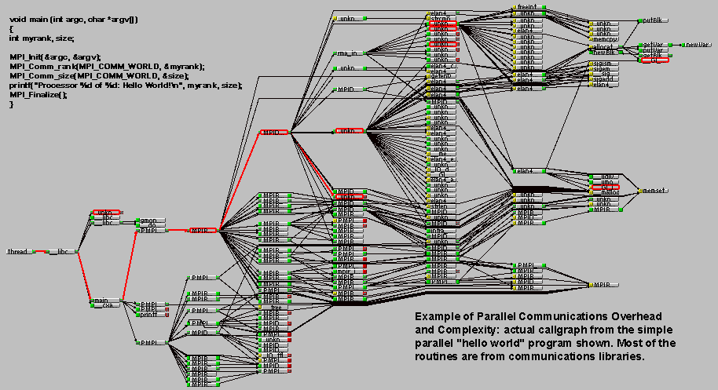
Overhead and Complexity

Slide 68
Synchronization
Managing the sequence of work and the tasks performing it is a critical design consideration for most parallel programs.
Can be a significant factor in program performance (or lack of it)
Often requires "serialization" of segments of the program.

Slide 69
Types of Synchronization
Barrier
Lock / semaphore
Synchronous communication operations

Slide 70
Barrier
Usually implies that all tasks are involved
Each task performs its work until it reaches the barrier. It then stops, or "blocks".
When the last task reaches the barrier, all tasks are synchronized.
What happens from here varies. Often, a serial section of work must be done. In other cases, the tasks are automatically released to continue their work.

Slide 71
Lock / semaphore
Can involve any number of tasks
Typically used to serialize (protect) access to global data or a section of code. Only one task at a time may use (own) the lock / semaphore / flag.
The first task to acquire the lock "sets" it. This task can then safely (serially) access the protected data or code.
Other tasks can attempt to acquire the lock but must wait until the task that owns the lock releases it.
Can be blocking or non-blocking

Slide 72
Synchronous communication operations
Involves only those tasks executing a communication operation
When a task performs a communication operation, some form of coordination is required with the other task(s) participating in the communication. For example, before a task can perform a send operation, it must first receive an acknowledgment from the receiving task that it is OK to send.

Slide 73
Data Dependencies
A dependence exists between program statements when the order of statement execution affects the results of the program.
A data dependence results from multiple use of the same location(s) in storage by different tasks.
Dependencies are important to parallel programming because they are one of the primary inhibitors to parallelism.

Slide 74
Loop carried data dependence
DO 500 J = MYSTART,MYEND
A(J) = A(J-1) * 2.0
500 CONTINUE
The value of A(J-1) must be computed before the value of A(J), therefore A(J) exhibits a data dependency on A(J-1). Parallelism is inhibited.
If Task 2 has A(J) and task 1 has A(J-1), computing the correct value of A(J) necessitates:
Distributed memory architecture - task 2 must obtain the value of A(J-1) from task 1 after task 1 finishes its computation
Shared memory architecture - task 2 must read A(J-1) after task 1 updates it

Slide 75
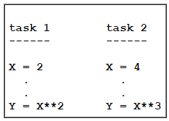
Loop independent data dependence
As with the previous example, parallelism is inhibited. The value of Y is dependent on:
Distributed memory architecture - if or when the value of X is communicated between the tasks.
Shared memory architecture - which task last stores the value of X.
Although all data dependencies are important to identify when designing parallel programs, loop carried dependencies are particularly important since loops are possibly the most common target of parallelization efforts.

Slide 76
How to Handle Data Dependencies
Distributed memory architectures - communicate required data at synchronization points.
Shared memory architectures -synchronize read/write operations between tasks.

Slide 77
Load Balancing
Load balancing refers to the practice of distributing approximately equal amounts of work among tasks so that all tasks are kept busy all of the time. It can be considered a minimization of task idle time.
Load balancing is important to parallel programs for performance reasons. For example, if all tasks are subject to a barrier synchronization point, the slowest task will determine the overall performance.

Slide 78
How to Achieve Load Balance
Equally partition the work each task receives
Use dynamic work assignment

Slide 79
Equally partition the work each task receives
For array/matrix operations where each task performs similar work, evenly distribute the data set among the tasks.
For loop iterations where the work done in each iteration is similar, evenly distribute the iterations across the tasks.
If a heterogeneous mix of machines with varying performance characteristics are being used, be sure to use some type of performance analysis tool to detect any load imbalances. Adjust work accordingly.

Slide 80
Use dynamic work assignment
Certain classes of problems result in load imbalances even if data is evenly distributed among tasks:
Sparse arrays - some tasks will have actual data to work on while others have mostly "zeros".
Adaptive grid methods - some tasks may need to refine their mesh while others don't.
N-body simulations - where some particles may migrate to/from their original task domain to another task's; where the particles owned by some tasks require more work than those owned by other tasks.
When the amount of work each task will perform is intentionally variable, or is unable to be predicted, it may be helpful to use a scheduler - task pool approach. As each task finishes its work, it queues to get a new piece of work.
It may become necessary to design an algorithm which detects and handles load imbalances as they occur dynamically within the code.

Slide 81
Granularity
Computation / Communication Ratio:
In parallel computing, granularity is a qualitative measure of the ratio of computation to communication.
Periods of computation are typically separated from periods of communication by synchronization events.

Slide 82
Fine-grain Parallelism
Relatively small amounts of computational work are done between communication events
Low computation to communication ratio
Facilitates load balancing
Implies high communication overhead and less opportunity for performance enhancement
If granularity is too fine it is possible that the overhead required for communications and synchronization between tasks takes longer than the computation

Slide 83
Coarse-grain Parallelism
Relatively large amounts of computational work are done between communication/synchronization events
High computation to communication ratio
Implies more opportunity for performance increase
Harder to load balance efficiently

Slide 84
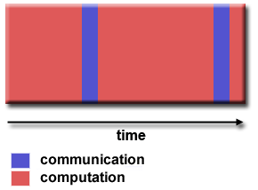
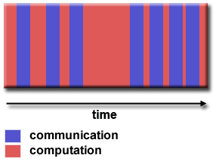

Slide 85
Which is Best?
The most efficient granularity is dependent on the algorithm and the hardware environment in which it runs.
In most cases the overhead associated with communications and synchronization is high relative to execution speed so it is advantageous to have coarse granularity.
Fine-grain parallelism can help reduce overheads due to load imbalance.

Slide 86
I/O The Bad News
I/O operations are generally regarded as inhibitors to parallelism.
I/O operations require orders of magnitude more time than memory operations.
Parallel I/O systems may be immature or not available for all platforms.
In an environment where all tasks see the same file space, write operations can result in file overwriting.
Read operations can be affected by the file server's ability to handle multiple read requests at the same time.
I/O that must be conducted over the network (NFS, non-local) can cause severe bottlenecks and even crash file servers.

Slide 87
I/O The Good News
Parallel file systems are available. For example:GPFS: General Parallel File System (IBM)
Lustre: for Linux clusters (Intel)
OrangeFS: Open source parallel file system follow on to Parallel Virtual File System (PVFS)
PanFS: Panasas ActiveScale File System for Linux clusters (Panasas, Inc.)
And more - see http://en.wikipedia.org/wiki/List_of_file_systems#Distributed_parallel_file_systems

Slide 88
Cont.
Rule #1: Reduce overall I/O as much as possible
If you have access to a parallel file system, use it.
Writing large chunks of data rather than small chunks is usually significantly more efficient.
Fewer, larger files performs better than many small files.
Confine I/O to specific serial portions of the job, and then use parallel communications to distribute data to parallel tasks. For example, Task 1 could read an input file and then communicate required data to other tasks. Likewise, Task 1 could perform write operation after receiving required data from all other tasks.
Aggregate I/O operations across tasks - rather than having many tasks perform I/O, have a subset of tasks perform it.

Slide 89
Parallel Examples: PI Calculation
The value of PI can be calculated in a number of ways. Consider the following method of approximating PI Inscribe a circle in a square:
Randomly generate points in the square
Determine the number of points in the square that are also in the circle
Let r be the number of points in the circle divided by the number of points in the square
PI ~ 4 r
Note that the more points generated, the better the approximation

Slide 90
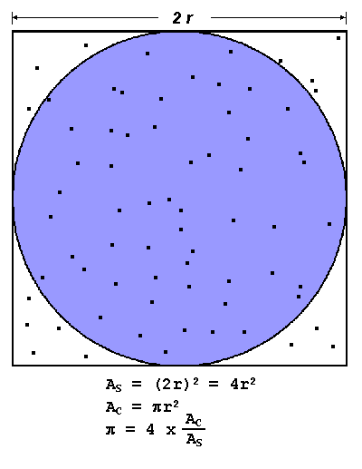

Slide 91
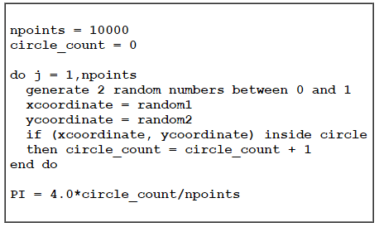
Pseudo code

Slide 92
Design
Is this problem able to be parallelized?
How would the problem be partitioned?
Are communications needed?
Are there any data dependencies?
Are there synchronization needs?
Will load balancing be a concern?

Slide 93
Parallel Solution
Another problem that's easy to parallelize:All point calculations are independent; no data dependencies
Work can be evenly divided; no load balance concerns
No need for communication or synchronization between tasks

Slide 94
Strategy
Divide the loop into equal portions that can be executed by the pool of tasks
Each task independently performs its work
A SPMD model is used
One task acts as the master to collect results and compute the value of PI

Slide 95
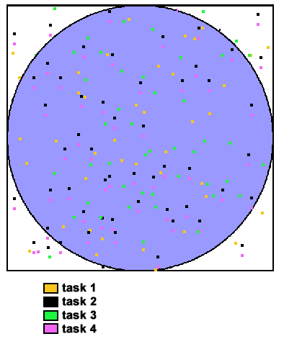

Slide 96
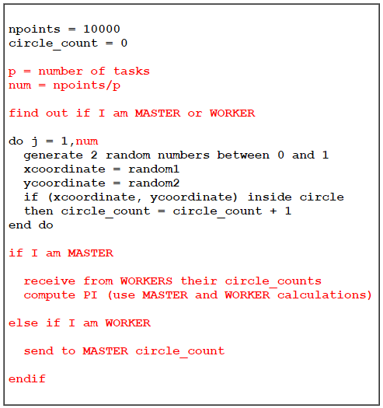

Slide 97
References
Blaise Barney, Lawrence Livermore National Laboratory
https://computing.llnl.gov/tutorials/parallel_comp/

